Slide 1
Create global temporary column table.
Milind Parab

Slide 2
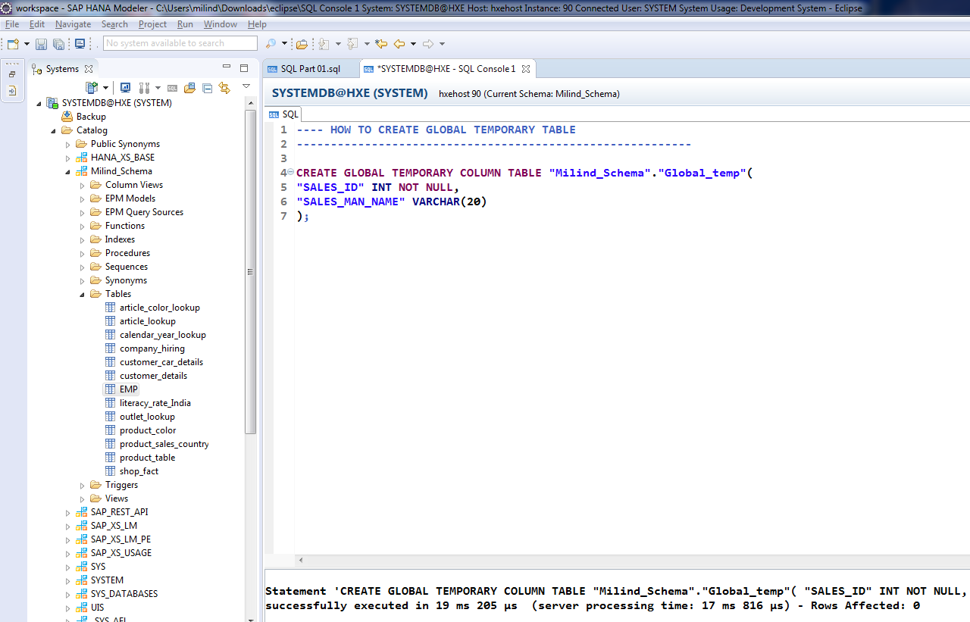
Create Global Temp Column Table.

Slide 3
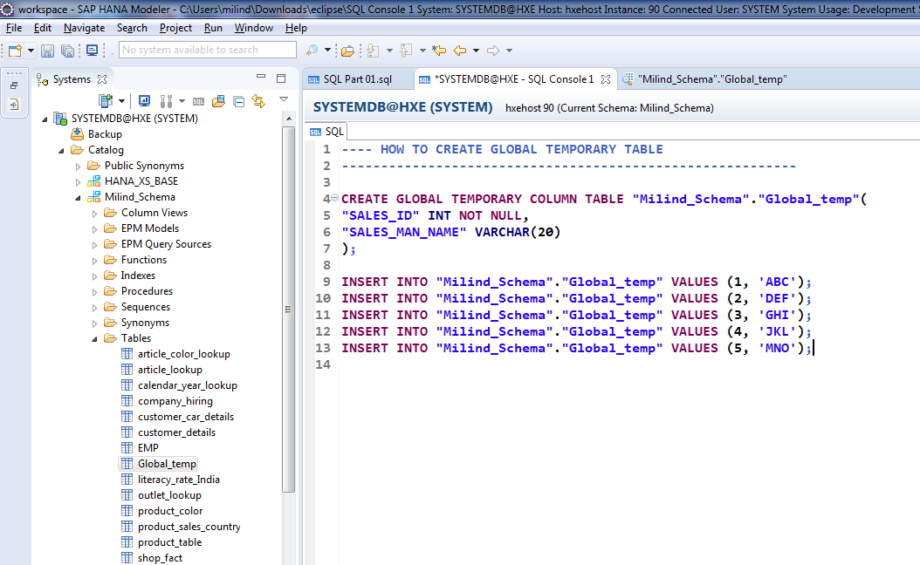
Cont.

Slide 4
Create local temporary column table.
Milind Parab

Slide 5
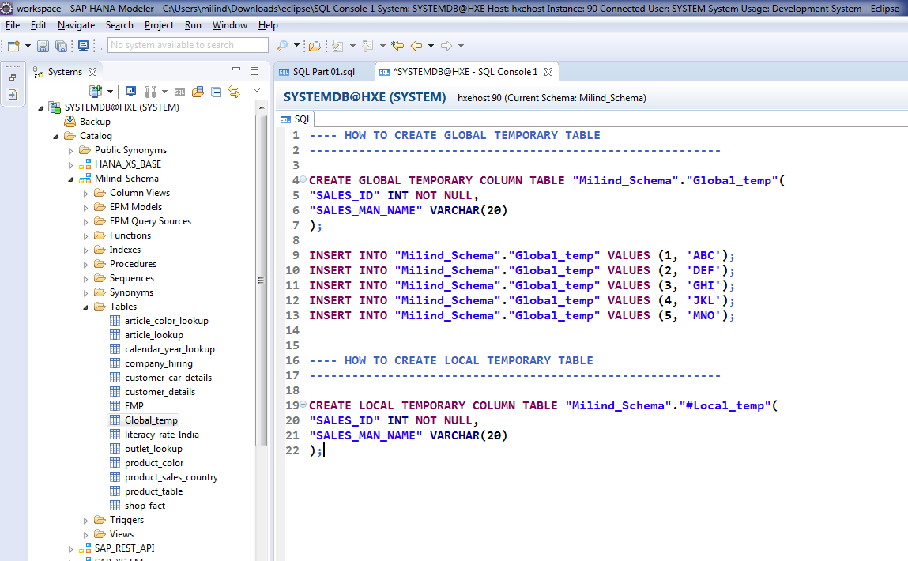
Create Local Temp Table.

Slide 6
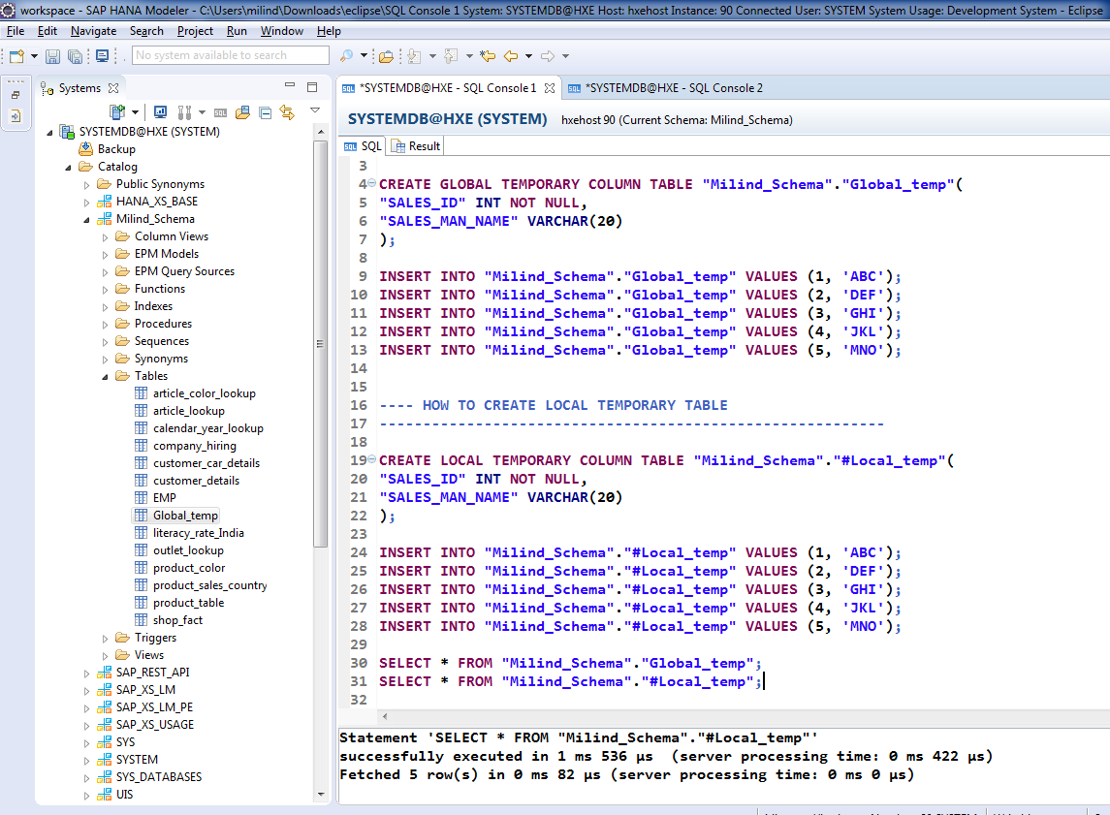
Cont.

Slide 7
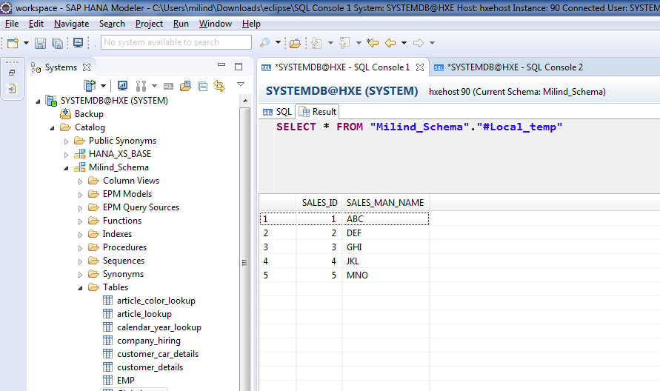
Local temp table, starts with “#” and data available in the same session.

Slide 8
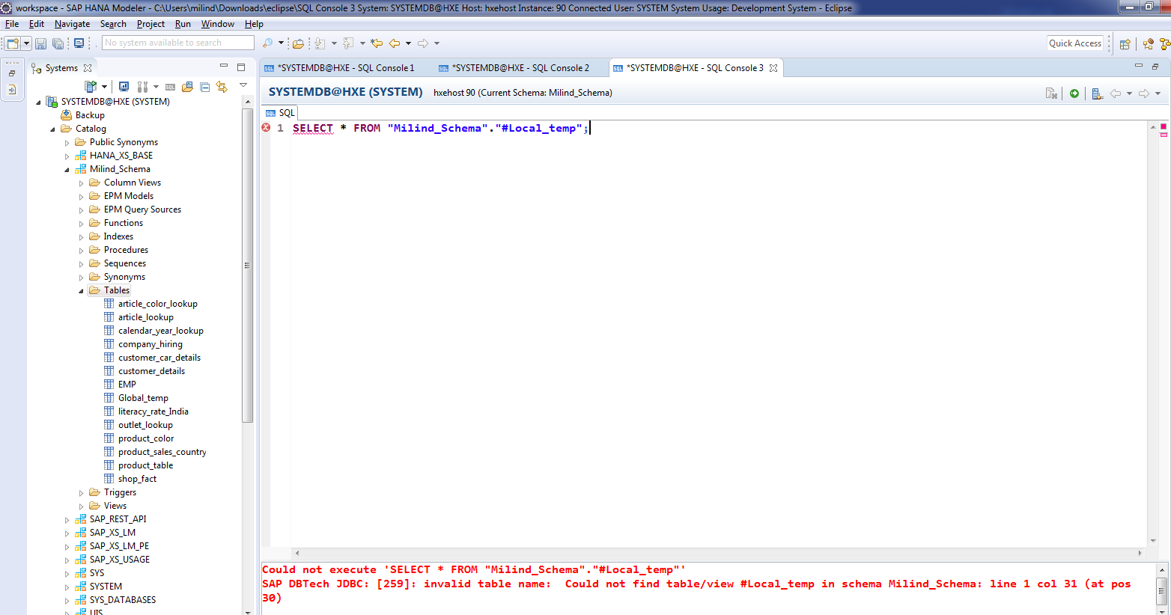
Can’t available outside the session.

Slide 9
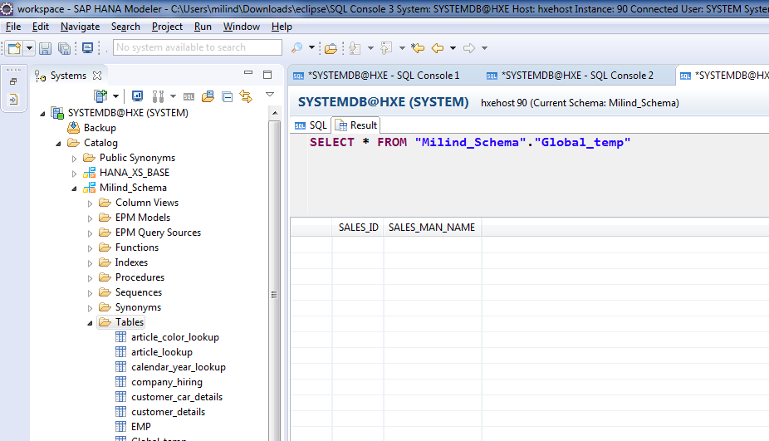
But global does available.

